Slide 1
Bayesian Networks (Chapters 12&13)
Dr. Shengquan Wang
Most slides are adopted from
Artificial Intelligence: A Modern Approach, 3rd ed. by Stuart Russell (UC Berkeley) and Peter Norvig (Google).
Peter Norvig and Sebastian Thrun for Intro to Artificial Intelligence at Udacity.

Slide 2

Example: Maze under Windy Situation
f
e
0.8
↑
0.1
0.1
d
c
0.1
b
↑
0.8
0.1
a
1
2
3
4
5
6
Notes:
Run 4 examples

Slide 3
Example: Car Diagnosis
battery age
alternator broken
fanbelt broken
battery dead
not charging
battery meter
battery flat
no oil
no gas
fuel line blocked
starter broken
lights
oil light
gas gauge
car won’t start
dipstick
link: uncertain/probabilistic

Slide 4
Example: Probabilistic Propositional Logic
Burglary
Earthquake
Alarm
MaryCalls
JohnCalls

Slide 5
Outline
Uncertainty

Slide 6
Example: Coin Flips
Coin flip | h | t | t, h | t, t, t
Probability | 0.5
0.5
0.5*0.5=0.25
0.5*0.5*0.5=0.125
Coin flip | h | t | t, h | t, t, h
Probability | 0.4
0.6
0.6*0.4=0.24
0.6*0.6*0.4=0.144

Slide 7
Properties of Probabilities
Random Variables X and Y
Complementary probability:
P(¬x) = 1 - P(x)
Independence:
X ⊥ Y: P(x, y) = P(x) P(y)
Notation:
P(x) ≡ P(X=x)
P(¬x) ≡ P(X=¬x)
P(y) ≡ P(Y=y)
P(x,y) ≡ P(X=x, Y=y)

Slide 8
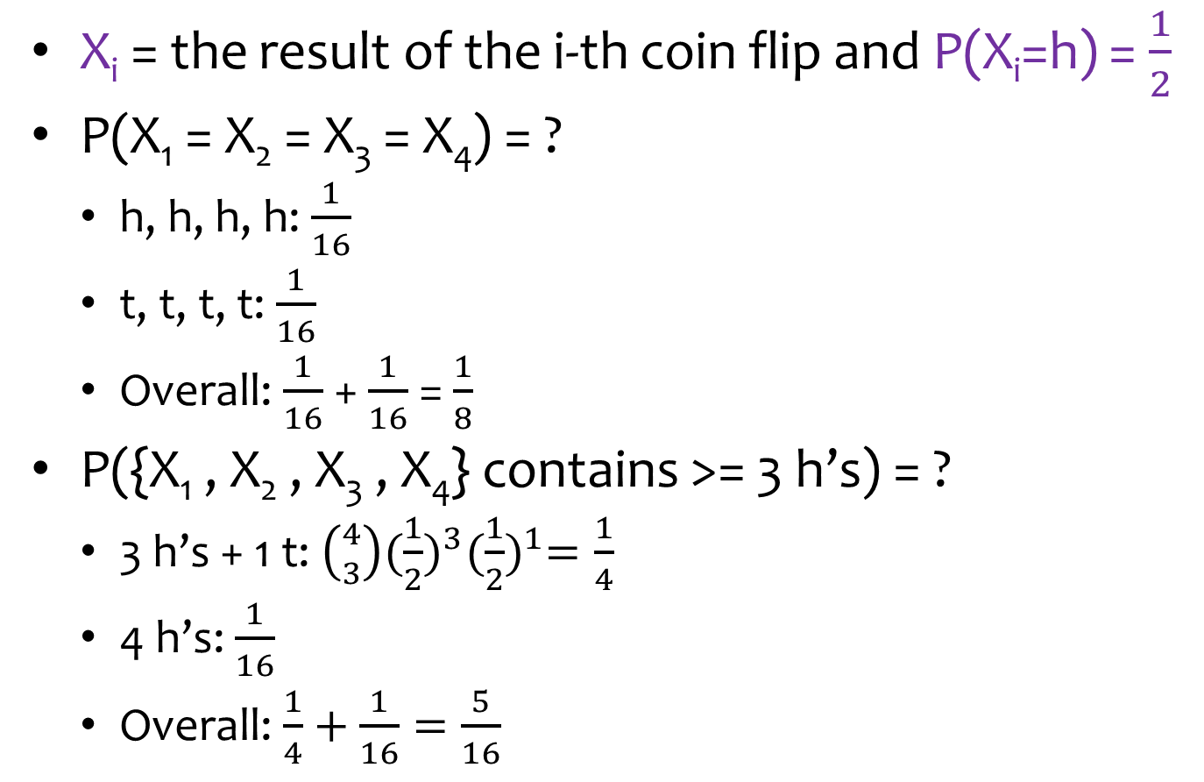
Example: Coin Flips (cont’d)
X_{i} = the result of the i-th coin flip and P(X_{i}=h) = $\frac{1}{2}$
P(X₁ = X₂ = X₃ = X₄) = ?
h, h, h, h: $\frac{1}{16}$
t, t, t, t: $\frac{1}{16}$
Overall: $\frac{1}{16}$ + $\frac{1}{16}$ = $\frac{1}{8}$
P({X₁ , X₂ , X₃ , X₄} contains >= 3 h’s) = ?
3 h’s + 1 t: $\left({4 \atop 3}\right){(\frac{1}{2})}^{3}{(\frac{1}{2})}^{1}=\frac{1}{4}$
4 h’s: $\frac{1}{16}$
Overall: $\frac{1}{4}+\frac{1}{16}=\frac{5}{16}$

Slide 9

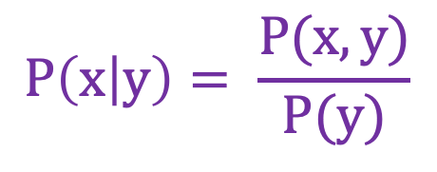
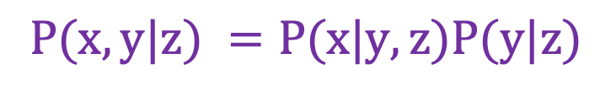
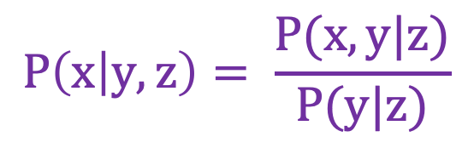
Conditional Probabilities
Notation:
P(x|y) ≡ P(X=x|Y=y)
$$P\left(x | y\right)= \frac{P(x,y)}{P(y)}$$
$$P\left(x,y\right)=P\left(x | y\right)P\left(y\right)$$
$$P\left(x | y,z\right)= \frac{P(x,y|z)}{P(y|z)}$$
$$P(x,y|z) =P(x|y,z)P(y|z)$$

Slide 10
Example on Conditional Probabilities
https://en.wikipedia.org/wiki/Conditional_probability
The probability that any given person has a cough on any given day may be only 5%:
P(Cough) = 5%
But if we know or assume that the person has a cold, then they are much more likely to be coughing.
The conditional probability that someone coughing has a cold might be 75%:
P(Cold | Cough) = 75%

Slide 11
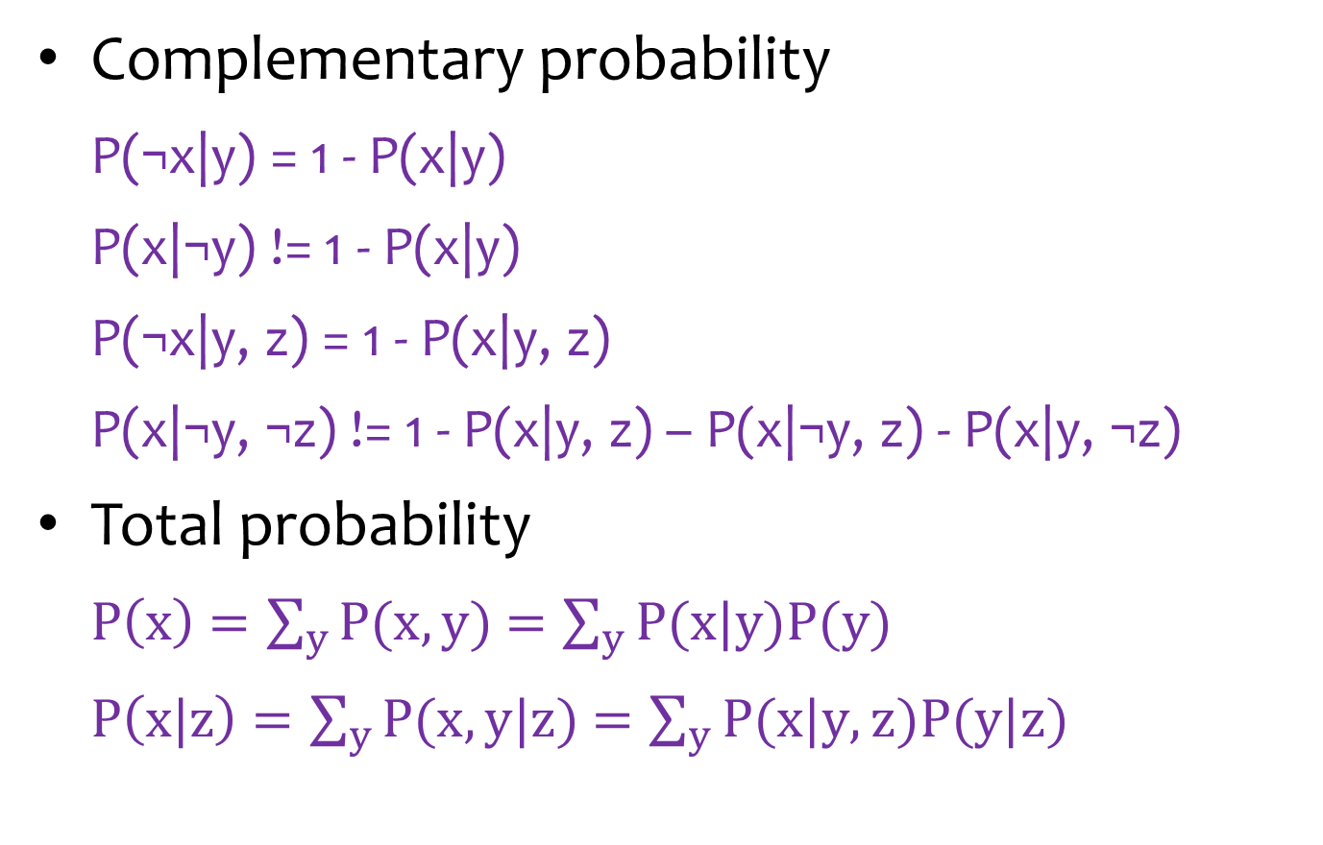
Properties of Conditional Probabilities
Complementary probability
P(¬x|y) = 1 - P(x|y)
P(x|¬y) != 1 - P(x|y)
P(¬x|y, z) = 1 - P(x|y, z)
P(x|¬y, ¬z) != 1 - P(x|y, z) – P(x|¬y, z) - P(x|y, ¬z)
Total probability
$P\left(x\right)$ $=\sum_{y}{P(x,y)}$ $=\sum_{y}{P(x|y)P(y)}$
$P\left(x|z\right)$ $=\sum_{y}{P(x,y|z)}$ $=\sum_{y}{P(x|y,z)P(y|z)}$

Slide 12
Example: Coin Flips (cont’d)
We have two coin flips, but the 2nd conditionally depends on the result of the 1st.
1st coin flip:
P(X₁=h) = 0.5
2nd coin flip:
P(X₂=h|X₁=h) = 0.9; P(X₂=t|X₁=t) = 0.8
P(X₂=h) = ?
= P(X₂=h|X₁=h) * P(X₁=h) + P(X₂=h|X₁=t) * P(X₁=t)
= 0.9 * 0.5 + (1 - 0.8) * (1 - 0.5) = 0.55

Slide 13

Quiz: Weather
Weather on two days: sunny or rainy
P(D₁=s) = 0.9
P(D₂=s | D₁=s) = 0.8
P(D₂=s | D₁=r) = 0.6
P(D₂=s) = ?
= 0.9 * 0.8 + 0.1 * 0.6 = 0.78
P(D₃=s) = ?
= 0.78 * 0.8 + 0.22 * 0.6 = 0.756

Slide 14
Outline
Uncertainty
Bayes’ Rule

Slide 15
Example: Librarian vs Farmer
https://www.youtube.com/watch?v=HZGCoVF3YvM
Steve was selected at random from a representative sample, who has been described by a neighbor as follows:
“Steve is very shy and withdrawn, invariably helpful but with little interest in people or in the world of reality. A meek and tidy soul, he has a need for order and structure, and a passion for detail.”
Is Steve more likely to be a librarian or a farmer?
Most people assume Steve is a librarian.
Actually, Steve is more likely a farmer.

Slide 16
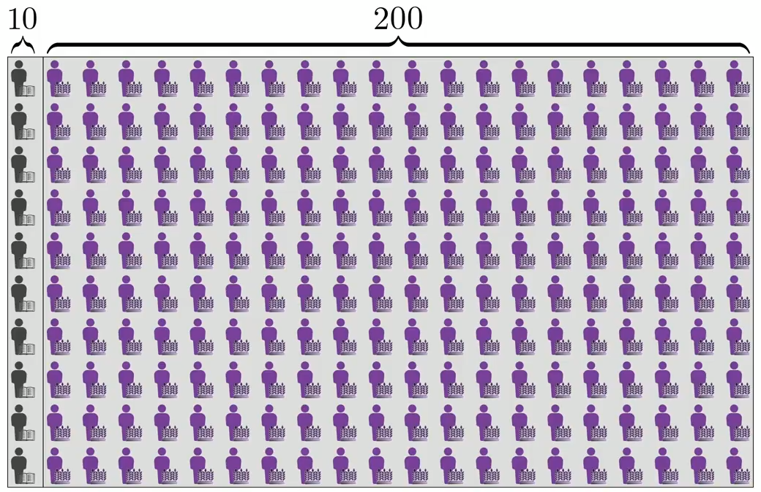
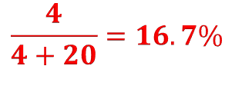
Example: Librarian vs Farmer (cont’d)
$$\frac{4}{4+20}=16.7\%$$
40%
10%

Slide 17
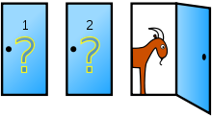

Example: Monty Hall Problem
Suppose you're on a game show, and you're given the choice of three doors:
Behind one door is a car;
behind the others, goats.
You pick a door, say No. 1, and the host, who knows what's behind the doors, opens another door, say No. 3, which has a goat.
He then says to you, "Do you want to pick door No. 2?"
Is it to your advantage to switch your choice?
3
https://en.wikipedia.org/wiki/Monty_Hall_problem

Slide 18
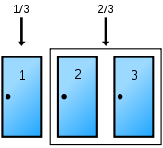
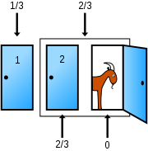
Example: Monty Hall Problem (cont’d)

Slide 19
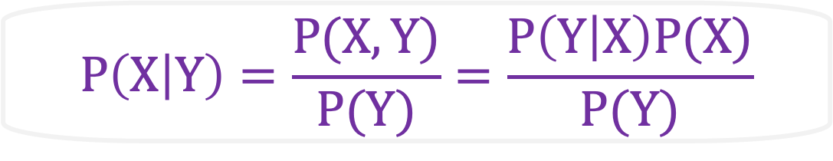
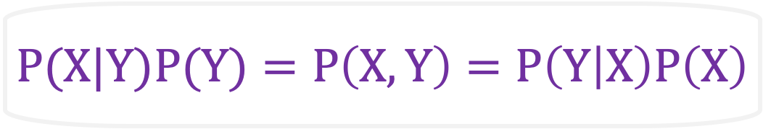
Summary: Bayes’ Rule
$$P(X|Y)P(Y)=P\left(X,Y\right)=P\left(Y | X\right)P\left(X\right)$$
likelihood
prior
posterior
$$P\left(X | Y\right)=\frac{P(X,Y)}{P(Y)}=\frac{P\left(Y | X\right)P(X)}{P(Y)}$$
marginal likelihood

Slide 20
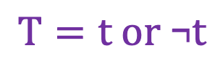
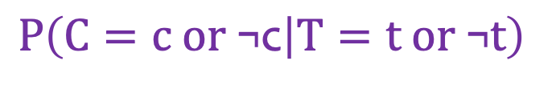

Diagnostic Reasoning
Cancer
hidden
Cancer: c (yes); ¬c (no)
$$P\left(C=c or \text{¬}\text{c} | T=t \text{or} \text{¬}t\right)$$
$$T=t \text{or} \text{¬}t$$
Test
evident
Test: t (positive); ¬t (negative)
$$P\left(C | T\right)= \frac{P(C,T)}{P(T)}= \frac{P\left(T | C\right) P(C)}{P(T)}$$

Slide 21
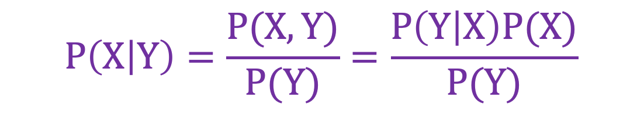
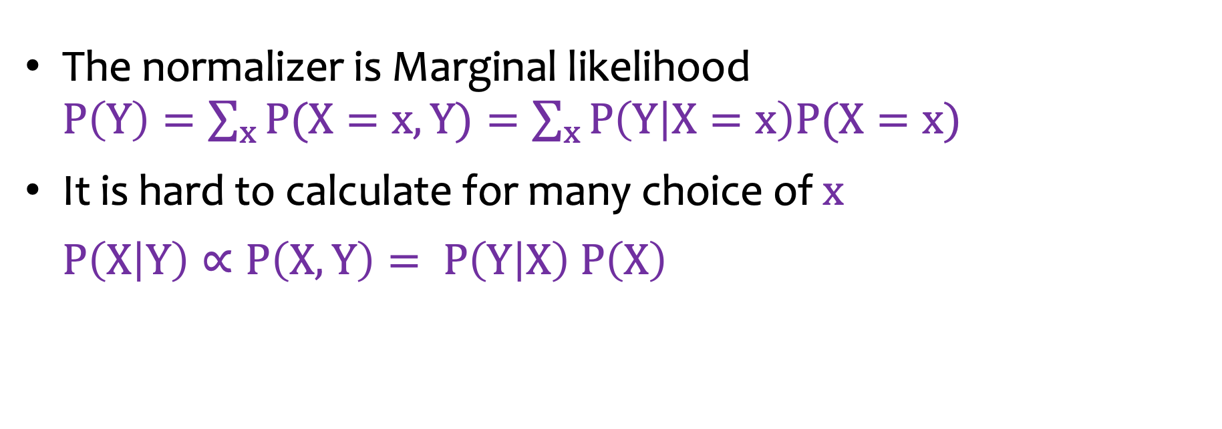
Bayes’ Rule: Normalizer
$$P\left(X | Y\right)=\frac{P(X,Y)}{P(Y)}=\frac{P\left(Y | X\right)P(X)}{P(Y)}$$
The normalizer is Marginal likelihood $P\left(Y\right)=\sum_{x}{P(X=x,Y)}=\sum_{x}{P\left(Y | X=x\right)P(X=x)}$
It is hard to calculate for many choice of $x$
$P\left(X | Y\right)∝P\left(X,Y\right)= P\left(Y | X\right) P\left(X\right)$

Slide 22
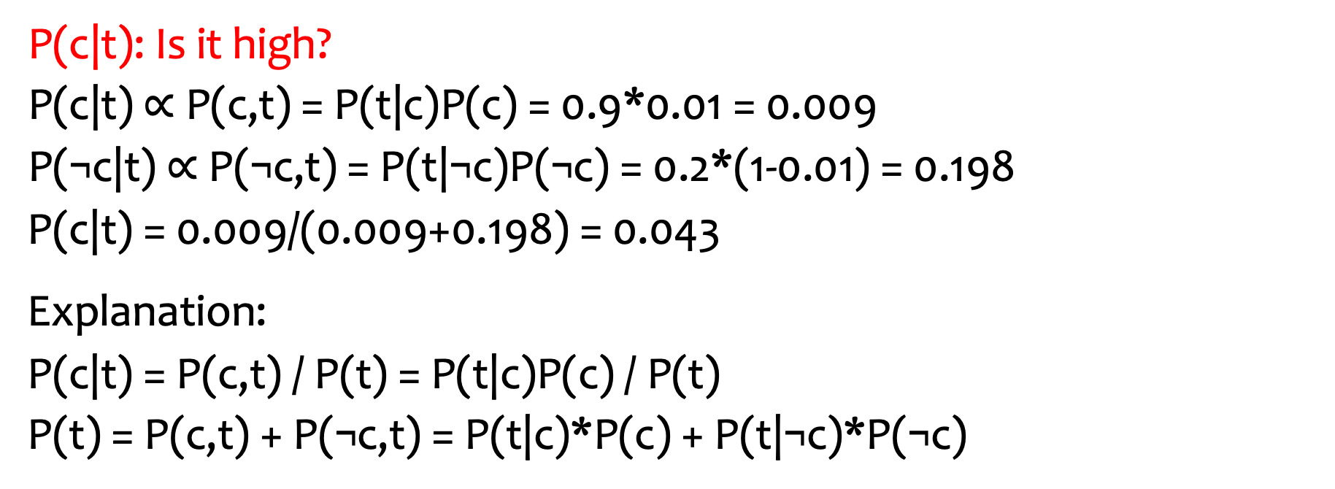
Example: 1-Test Cancer
P(c) = 0.01
P(t|c) = 0.9
P(t|¬c) = 0.2
C
T
P(c|t): Is it high?
P(c|t) $∝$ P(c,t) = P(t|c)P(c) = 0.9*0.01 = 0.009
P(¬c|t) $∝$ P(¬c,t) = P(t|¬c)P(¬c) = 0.2*(1-0.01) = 0.198
P(c|t) = 0.009/(0.009+0.198) = 0.043
Explanation:
P(c|t) = P(c,t) / P(t) = P(t|c)P(c) / P(t)
P(t) = P(c,t) + P(¬c,t) = P(t|c)*P(c) + P(t|¬c)*P(¬c)

Slide 23
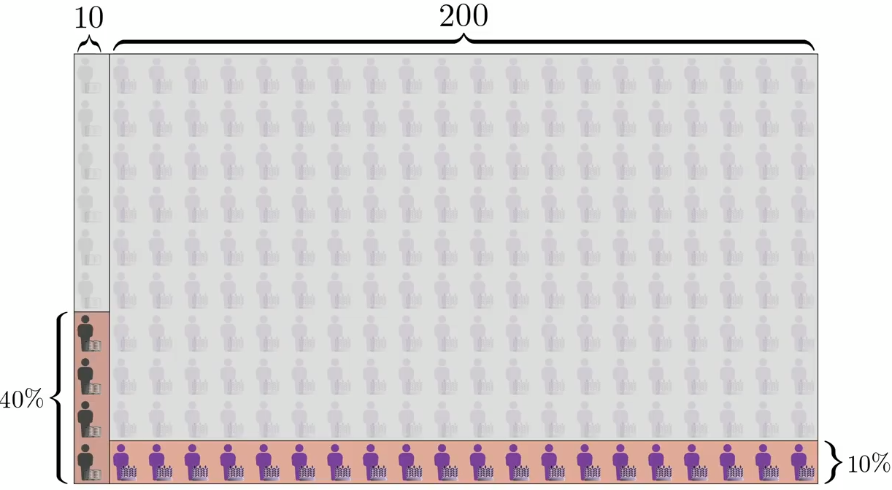
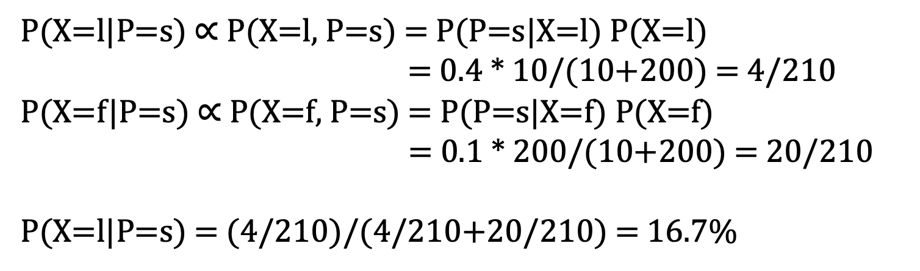
Applying Bayes’ Rule in Librarian vs Farmer
X: l - librarian; f - farmer
P: s - very shy and withdrawn; o - outgoing
P(X=l|P=s) $∝$ P(X=l, P=s) = P(P=s|X=l) P(X=l)
= 0.4 * 10/(10+200) = 4/210
P(X=f|P=s) $∝$ P(X=f, P=s) = P(P=s|X=f) P(X=f)
= 0.1 * 200/(10+200) = 20/210
P(X=l|P=s) = (4/210)/(4/210+20/210) = 16.7%

Slide 24
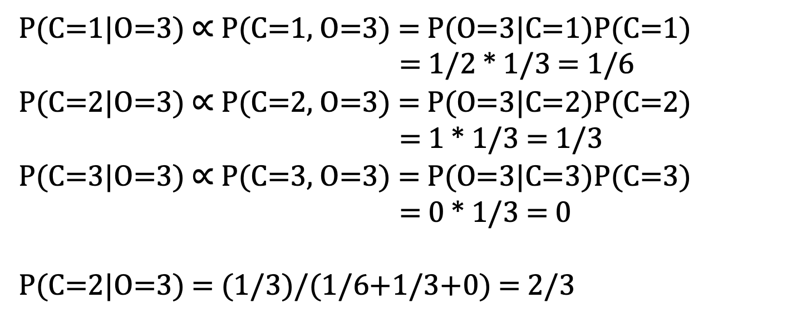
Applying Bayes’ Rule in Monty Hall Problem
C: the door that the car is behind
O: the door that is opened
P(C=1|O=3) $∝$ P(C=1, O=3) = P(O=3|C=1)P(C=1)
= 1/2 * 1/3 = 1/6
P(C=2|O=3) $∝$ P(C=2, O=3) = P(O=3|C=2)P(C=2)
= 1 * 1/3 = 1/3
P(C=3|O=3) $∝$ P(C=3, O=3) = P(O=3|C=3)P(C=3)
= 0 * 1/3 = 0
P(C=2|O=3) = (1/3)/(1/6+1/3+0) = 2/3

Slide 25
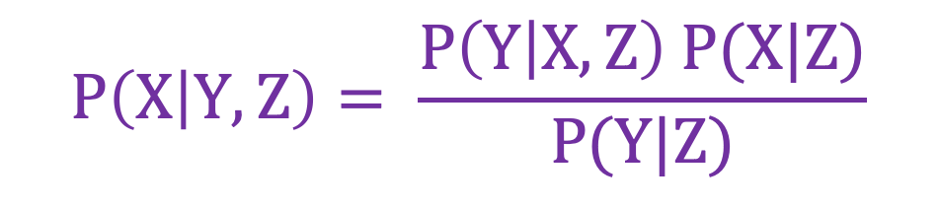
Bayes’ Rule: More Conditional Variables
$$P\left(X | Y,Z\right)= \frac{P\left(Y | X,Z\right) P(X|Z)}{P(Y|Z)}$$

Slide 26
Outline
Uncertainty
Bayes’ Rule
Bayesian Networks

Slide 27
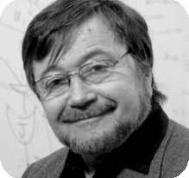
Judea Pearl: Turing Award (2011)
https://amturing.acm.org/award_winners/pearl_2658896.cfm

Slide 28
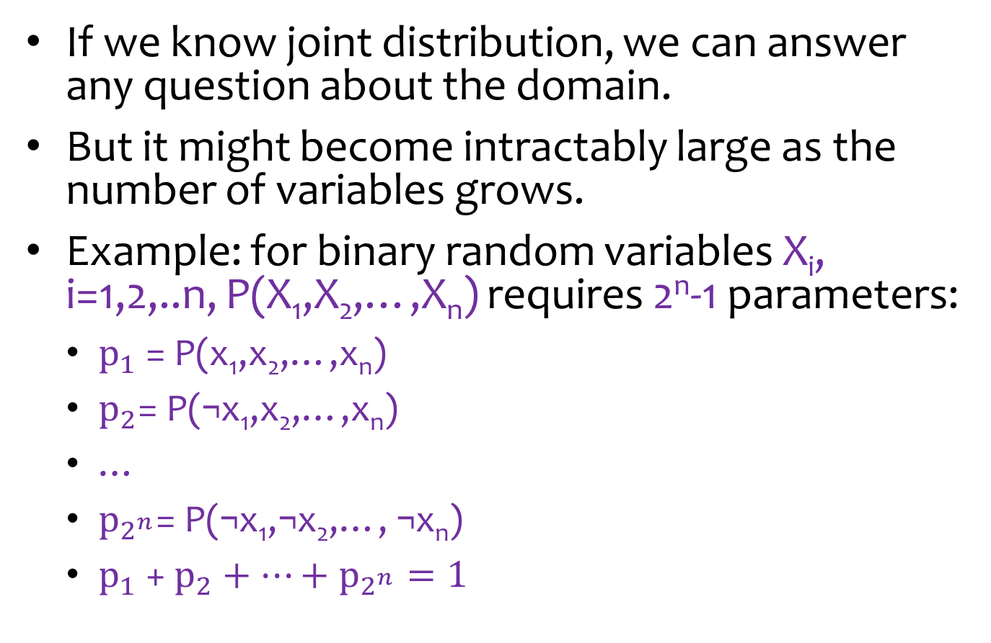
Intractability of Joint Distribution
If we know joint distribution, we can answer any question about the domain.
But it might become intractably large as the number of variables grows.
Example: for binary random variables X_{i}, i=1,2,..n, P(X₁,X₂,…,X_{n}) requires 2^{n}-1 parameters:
$p_{1}$ = P(x₁,x₂,…,x_{n})
$p_{2}$= P(¬x₁,x₂,…,x_{n})
…
$p_{2^{n}}$= P(¬x₁,¬x₂,…, ¬x_{n})
$p_{1}$ + $p_{2}+…+p_{2^{n}}=1$

Slide 29
Bayesian Networks
A Bayesian network is a data structure to represent the dependencies/independencies among variables.
Using independence can reduce the number of parameters for joint distribution.
X
Y
Z
Y
Z
X
P(X,Y,Z) =
P(X) P(Y|X) P(Z|X)
P(X,Y,Z) =
P(Y) P(Z) P(X|Y,Z)

Slide 30
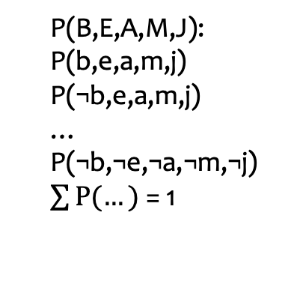
Complex Bayesian Networks
Burglary
Earthquake
B,E,A,M,J: binary discrete variables
Node probability depends on the arcs: P(B), P(E), P(A|B,E), P(M|A), P(J|A)
Alarm
MaryCalls
JohnCalls
P(B,E,A,M,J) = P(B) P(E) P(A|B,E) P(M|A) P(J|A)
P(B,E,A,M,J):
P(b,e,a,m,j)
P(¬b,e,a,m,j)
…
P(¬b,¬e,¬a,¬m,¬j)
$\sum{P(…)}$ = 1
P(B):
P(b); P(¬b)=1-P(b)
P(M|A):
P(m|a); P(¬m|a)=1-P(m|a)
P(m|¬a); P(¬m|¬a)=1-P(m|¬a)
1 parameter
2 parameters
P(A|B,E):
P(a|b,e); P(¬a|b,e)=1-P(a|b,e)
P(a|¬b,e); P(¬a|¬b,e)=1-P(a|¬b,e)
P(a|b,¬e); P(¬a|b,¬e)=1-P(a|b,¬e)
P(a|¬b,¬e); P(¬a|¬b,¬e)=1-P(a|¬b,¬e)
2⁵-1 = 31 parameters
4 parameters

Slide 31
Complex Bayesian Networks
Burglary
Earthquake
B,E,A,M,J: binary discrete variables
Node probability depends on the arcs: P(B), P(E), P(A|B,E), P(M|A), P(J|A)
Alarm
MaryCalls
JohnCalls
P(B,E,A,M,J) = P(B) P(E) P(A|B,E) P(M|A) P(J|A)
# of probability parameters
2⁵ - 1
1
+
1
+
4
+
2
+
2
= 31
= 10
Compact!

Slide 32
Quiz
A
B
C
A,B,C,D,E,F,G: binary discrete variables
P(A,B,C,D,E,F,G) = ?
# of probability parameters = ?
D
E
F
G
P(A,B,C,D,E,F,G) = P(A) P(B) P(C) P(D|A,B,C) P(E|D) P(F|D) P(G|C,D)
2⁷ - 1
1
+
1
+
1
+
8
+
2
+
2
+
4
= 127
= 19

Slide 33
Quiz: Car Diagnosis
All: binary variables
Without Bayesian Network model: 2¹⁶-1 = 65535 probability parameters
1
1
1
battery age
alternator broken
fanbelt broken
battery dead
2
not charging
4
1
1
1
1
2
battery meter
battery flat
4
no oil
no gas
fuel line blocked
starter broken
2
lights
4
oil light
4
gas gauge
32
car won’t start
dipstick
2
With Bayesian Network model: 63

Slide 34


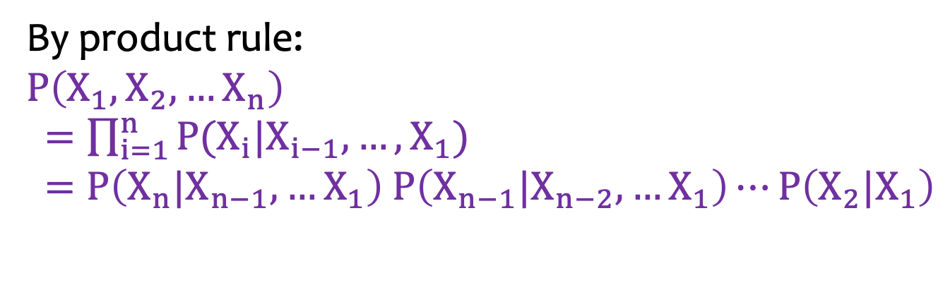



Constructing a General Bayesian Network
By product rule:
$$P\left(X_{1},X_{2},…X_{n}\right)$$
$=\prod_{i=1}^{n}{P(X_{i}|X_{i−1},…,X_{1})}$ $=P\left(X_{n}|X_{n−1},…X_{1}\right) P\left(X_{n−1}|X_{n−2},…X_{1}\right)⋯P\left(X_{2}|X_{1}\right)$
$$X_{1}$$
$$X_{2}$$
$$X_{5}$$
$$X_{3}$$
$$X_{4}$$

Slide 35





Quiz: a General Bayesian Network
By product rule:
$$P\left(X_{1},X_{2},…X_{n}\right)$$
$=\prod_{i=1}^{n}{P(X_{i}|X_{i−1},…,X_{1})}$ $=P\left(X_{n}|X_{n−1},…X_{1}\right) P\left(X_{n−1}|X_{n−2},…X_{1}\right)⋯P\left(X_{2}|X_{1}\right)$
1
$$X_{1}$$
All: binary variables
2
$$X_{2}$$
$$X_{5}$$
16
$$X_{3}$$
$$X_{4}$$
4
8
1+2+4+8+16=2⁵-1 parameters

Slide 36
Bayesian Network for Independent Variables
$P\left(X_{1},X_{2},…X_{n}\right)$ $=P\left(X_{1}\right)P\left(X_{2}\right)⋯P\left(X_{n}\right)$
1
All: binary variables
$$X_{1}$$
1
$$X_{2}$$
$$X_{5}$$
1
$$X_{3}$$
$$X_{4}$$
1
1
5 parameters

Slide 37
Outline
Uncertainty
Bayes’ Rule
Bayesian Networks
D-Separation

Slide 38
D-Separation
evidence
A and B are d-separated iff every undirected path from A to B is “blocked”.
A path is “blocked” iff one or more of the following conditions is true:
There exists an evidence variable C on the path such that ->C->.
There exists an evidence variable C on the path such that <-C->.
There exists a variable C on the path such that neither it or any of its descendants is an evidence variable and ->C<-.
A
C
B
C
A
B
A
B
C
D
E

Slide 39
d-separation and Conditional Independence
if two variables are d-separated relative to a set of variables Z in a directed graph, then they are independent conditional on Z in all probability distributions such a graph can represent.

Slide 40
Example: d-separated
A
 | T/F
C⊥A
C⊥A|B
C⊥D
C⊥D|A
E⊥C|D
F
B
D
T
F
C
E
T
T

Slide 41
Quiz: d-separated
A
C
F
 | T/F
F⊥A
F⊥A|D
F⊥A|G
F⊥A|H
B
E
T
F
H
D
F
G
T

Slide 42
Quiz: d-separated
 | T/F
A⊥E
A⊥E|B
A⊥E|C
A⊥B
A⊥B|C
D⊥E|B
F⊥G
F⊥G|E
F
A
B
F
T
F
C
G
T
F
D
E
F
T
F

Slide 43
Outline
Uncertainty
Bayes’ Rule
Bayesian Networks
D-Separation
Exact Inference

Slide 44
Example
B
E
B,E,A,M,J:
binary random variables
M=m
Evidence variables
Hidden variables
Query variables
A
J, A, E
B=b
M
J
Mary calls to report the Alarm is ringing, and we want to know if there is a burglary.
The alarm might not be going off when Mary could be mistaken or lying.

Slide 45
Quiz
B
E
Evidence variables
Hidden variables
Query variables
J=j,
M=m
A
E, A
M
J
B=b
Both Mary and John call to report the Alarm is ringing, we want to know if there is a Burglary.

Slide 46
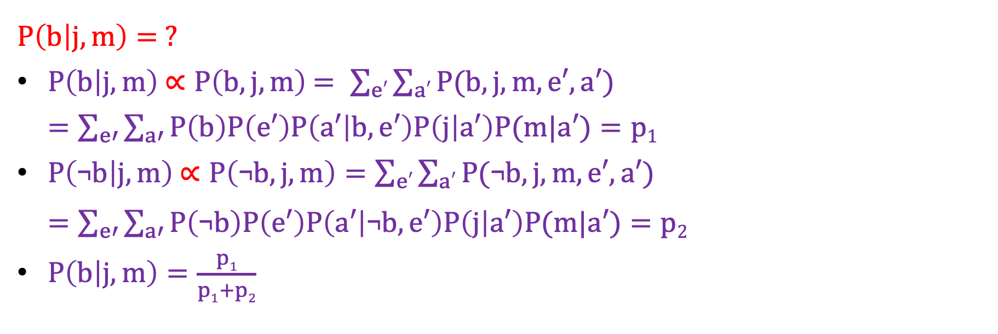
Inference by Enumeration
B
E
Evidence variables
Hidden variables
Query variables
J=j,
M=m
A
E, A
M
J
B=b
$P\left(b | j,m\right)= ?$
$P\left(b | j,m\right)$ $∝P\left(b, j, m\right)$ $= \sum_{e′}{\sum_{a′}{P(b,j,m,e′,a′)}}$
$=\sum_{e′}{\sum_{a′}{P\left(b\right)P\left(e′\right)P\left(a′ | b,e′\right)P\left(j | a′\right)P(m|a′)}}=p1$
$P\left(\text{¬}b | j,m\right)$ $∝P\left(\text{¬}b, j, m\right)=\sum_{e′}{\sum_{a′}{P(\text{¬}b,j,m,e′,a′)}}$
$=\sum_{e′}{\sum_{a′}{P\left(\text{¬}b\right)P\left(e′\right)P\left(a′ | \text{¬}b,e′\right)P\left(j | a′\right)P(m|a′)}}=p2$
$P\left(b | j,m\right)=\frac{p1}{p1+p2}$

Slide 47
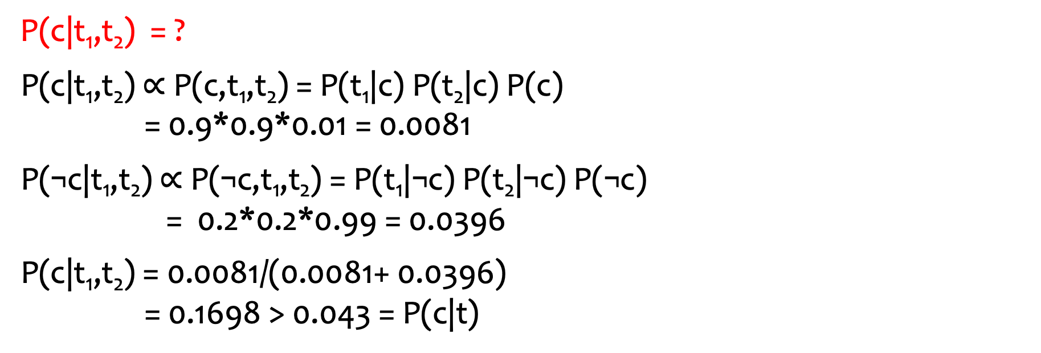
Example: 2-Test Cancer
C
P(c) = 0.01
P(t₁|c) = P(t₂|c) = 0.9
P(t₁|¬c) = P(t₂|¬c) = 0.2
T₁
T₂
P(c|t₁,t₂) = ?
P(c|t₁,t₂) $∝$ P(c,t₁,t₂) = P(t₁|c) P(t₂|c) P(c) = 0.9*0.9*0.01 = 0.0081
P(¬c|t₁,t₂) $∝$ P(¬c,t₁,t₂) = P(t₁|¬c) P(t₂|¬c) P(¬c) = 0.2*0.2*0.99 = 0.0396
P(c|t₁,t₂) = 0.0081/(0.0081+ 0.0396) = 0.1698 > 0.043 = P(c|t)

Slide 48

Example: 2-Test Cancer
C
P(c) = 0.01
P(t₁|c) = P(t₂|c) = 0.9
P(t₁|¬c) = P(t₂|¬c) = 0.2
T₁
T₂
P(t₁) = ?
= $\sum_{c′}{\sum_{t_{2}^{′}}{P(c^{′},t1{, t}_{2}^{′})}}$
= $\sum_{c′}{\sum_{t_{2}^{′}}{P({t1|c}^{′})P({t_{2}^{′}|c}^{′})P(c^{′})}}$
= $\sum_{c′}{P({t1|c}^{′})P(c^{′})}$
= P(t₁|c)P(c) + P(t₁|¬c)P(¬c)
= 0.9*0.01 + 0.2*0.99 = 0.207

Slide 49
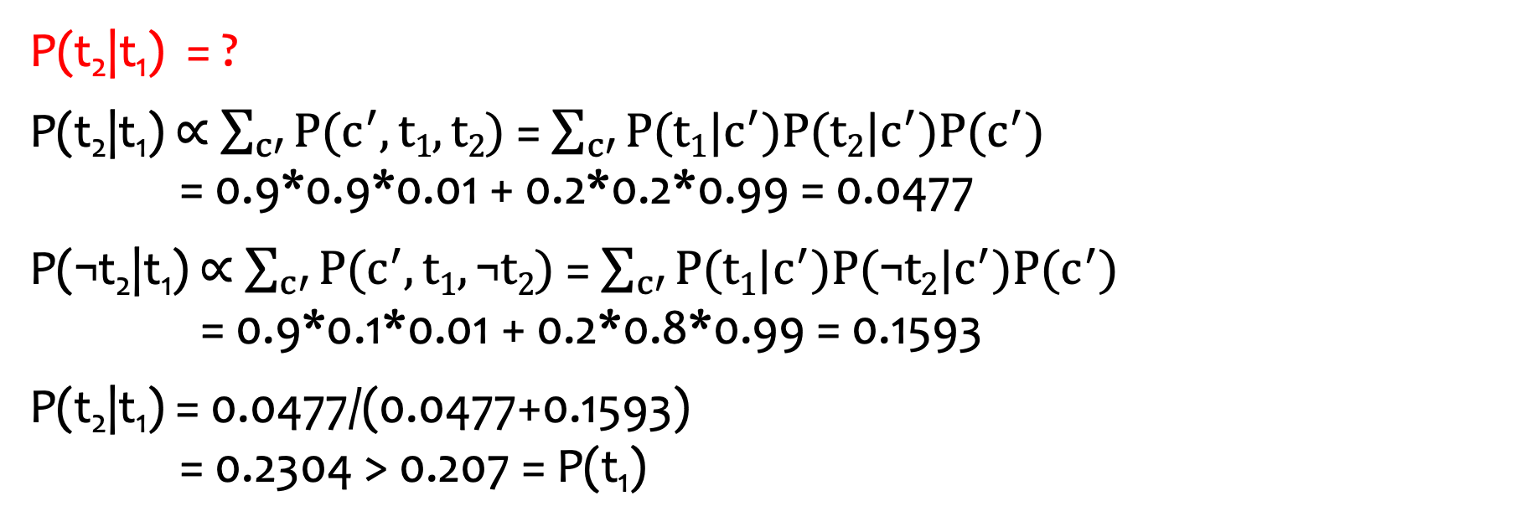
Example: 2-Test Cancer
C
P(c) = 0.01
P(t₁|c) = P(t₂|c) = 0.9
P(t₁|¬c) = P(t₂|¬c) = 0.2
T₁
T₂
P(t₂|t₁) = ?
P(t₂|t₁) $∝$ $\sum_{c′}{P(c^{′},t1,t2)}$= $\sum_{c′}{P({t1|c}^{′})P({t2|c}^{′})P(c^{′})}$ = 0.9*0.9*0.01 + 0.2*0.2*0.99 = 0.0477
P(¬t₂|t₁) $∝$ $\sum_{c′}{P(c^{′},t1,\text{¬}t2)}$= $\sum_{c′}{P({t1|c}^{′})P({\text{¬}t2|c}^{′})P(c^{′})}$ = 0.9*0.1*0.01 + 0.2*0.8*0.99 = 0.1593
P(t₂|t₁) = 0.0477/(0.0477+0.1593) = 0.2304 > 0.207 = P(t₁)

Slide 50
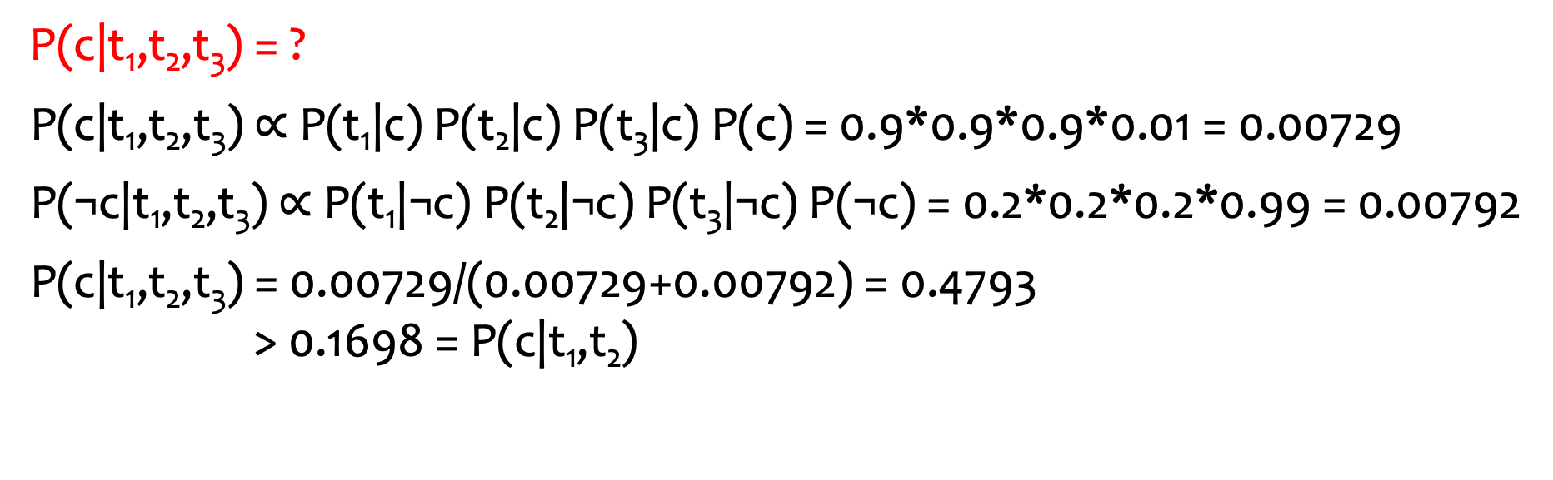
Quiz: 3-Test Cancer
C
P(c) = 0.01
P(t₁|c) = P(t₂|c) = P(t₃|c) = 0.9
P(t₁|¬c) = P(t₂|¬c) = P(t₃|¬c) = 0.2
T₁
T₂
T₃
P(c|t₁,t₂,t₃) = ?
P(c|t₁,t₂,t₃) $∝$ P(t₁|c) P(t₂|c) P(t₃|c) P(c) = 0.9*0.9*0.9*0.01 = 0.00729
P(¬c|t₁,t₂,t₃) $∝$ P(t₁|¬c) P(t₂|¬c) P(t₃|¬c) P(¬c) = 0.2*0.2*0.2*0.99 = 0.00792
P(c|t₁,t₂,t₃) = 0.00729/(0.00729+0.00792) = 0.4793 > 0.1698 = P(c|t₁,t₂)

Slide 51
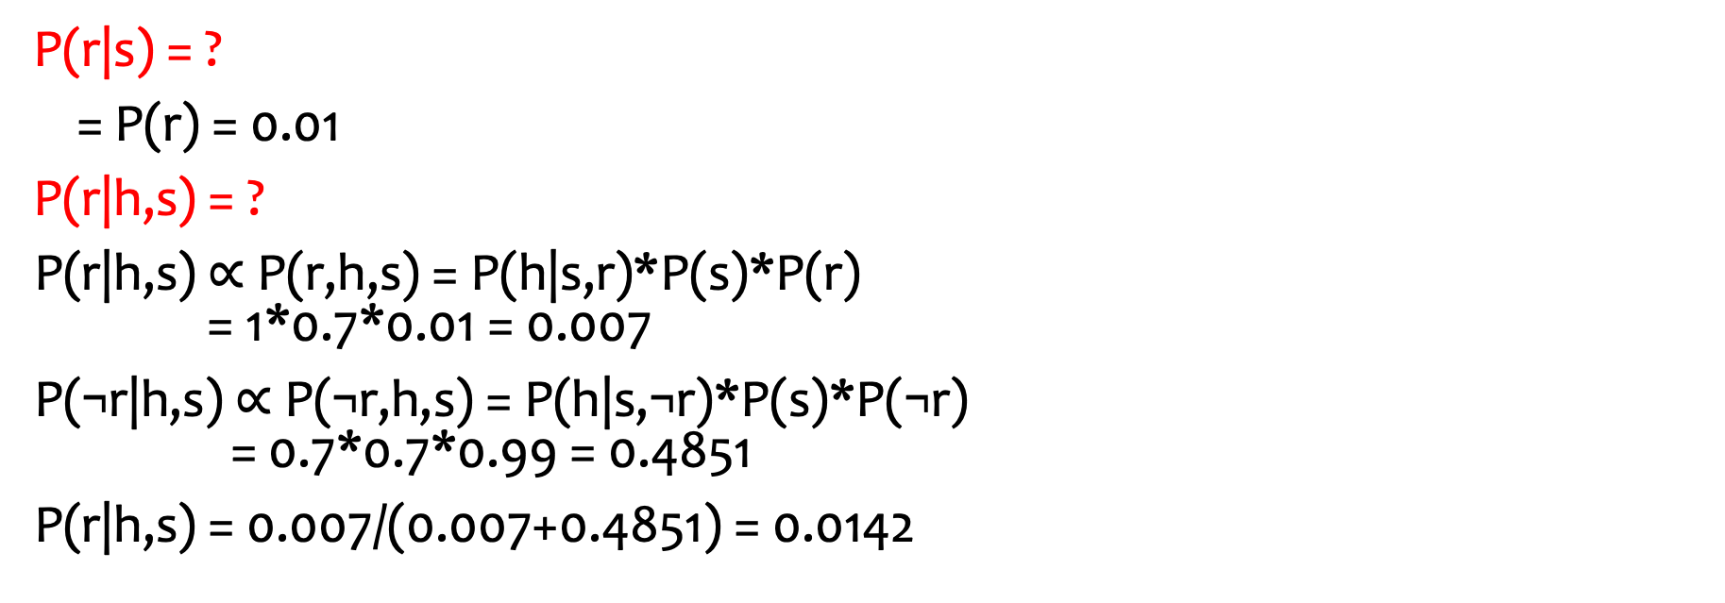
Confounding Causes
sunny day
salary raise
S
R
P(s) = 0.7 P(r) = 0.01
P(h|s,r) = 1 P(h|¬s,r) = 0.9
P(h|s,¬r) = 0.7 P(h|¬s,¬r) = 0.1
H
feeling happy
P(r|s) = ?
= P(r) = 0.01
P(r|h,s) = ?
P(r|h,s) $∝$ P(r,h,s) = P(h|s,r)*P(s)*P(r) = 1*0.7*0.01 = 0.007
P(¬r|h,s) $∝$ P(¬r,h,s) = P(h|s,¬r)*P(s)*P(¬r) = 0.7*0.7*0.99 = 0.4851
P(r|h,s) = 0.007/(0.007+0.4851) = 0.0142

Slide 52
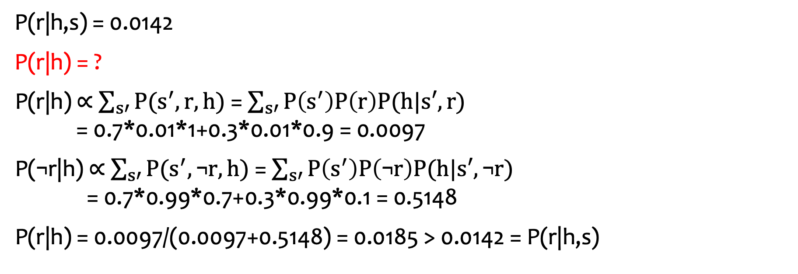
Confounding Causes
S
R
P(s) = 0.7 P(r) = 0.01
P(h|s,r) = 1 P(h|¬s,r) = 0.9
P(h|s,¬r) = 0.7 P(h|¬s,¬r) = 0.1
H
P(r|h,s) = 0.0142
P(r|h) = ?
P(r|h) $∝$ $\sum_{s′}{P(s^{′},r,h)}$= $\sum_{s′}{P\left(s^{′}\right)P\left(r\right)P(h|s′,r)}$ = 0.7*0.01*1+0.3*0.01*0.9 = 0.0097
P(¬r|h) $∝$ $\sum_{s′}{P(s^{′},\text{¬}r,h)}$= $\sum_{s′}{P\left(s^{′}\right)P\left(\text{¬}r\right)P(h|s′,\text{¬}r)}$ = 0.7*0.99*0.7+0.3*0.99*0.1 = 0.5148
P(r|h) = 0.0097/(0.0097+0.5148) = 0.0185 > 0.0142 = P(r|h,s)
Explaining away:
If I’m feeling happy and it is sunny, it is less likely that I’ve got salary raise.

Slide 53
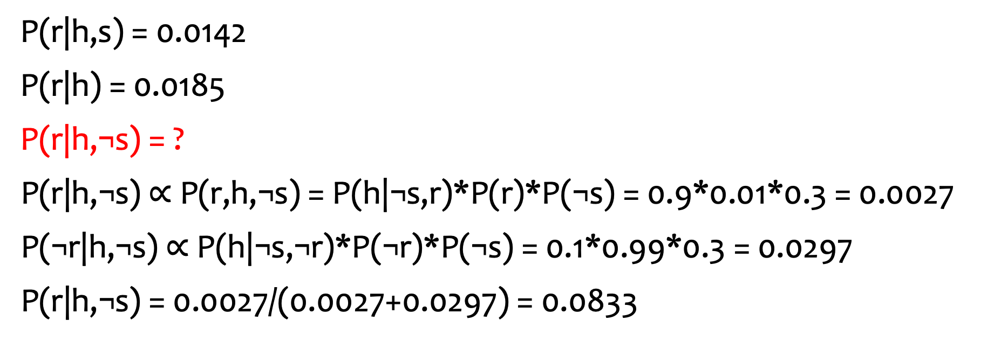
Confounding Causes
S
R
P(s) = 0.7 P(r) = 0.01
P(h|s,r) = 1 P(h|¬s,r) = 0.9
P(h|s,¬r) = 0.7 P(h|¬s,¬r) = 0.1
H
P(r|h,s) = 0.0142
P(r|h) = 0.0185
P(r|h,¬s) = ?
P(r|h,¬s) $∝$ P(r,h,¬s) = P(h|¬s,r)*P(r)*P(¬s) = 0.9*0.01*0.3 = 0.0027
P(¬r|h,¬s) $∝$P(h|¬s,¬r)*P(¬r)*P(¬s) = 0.1*0.99*0.3 = 0.0297
P(r|h,¬s) = 0.0027/(0.0027+0.0297) = 0.0833

Slide 54
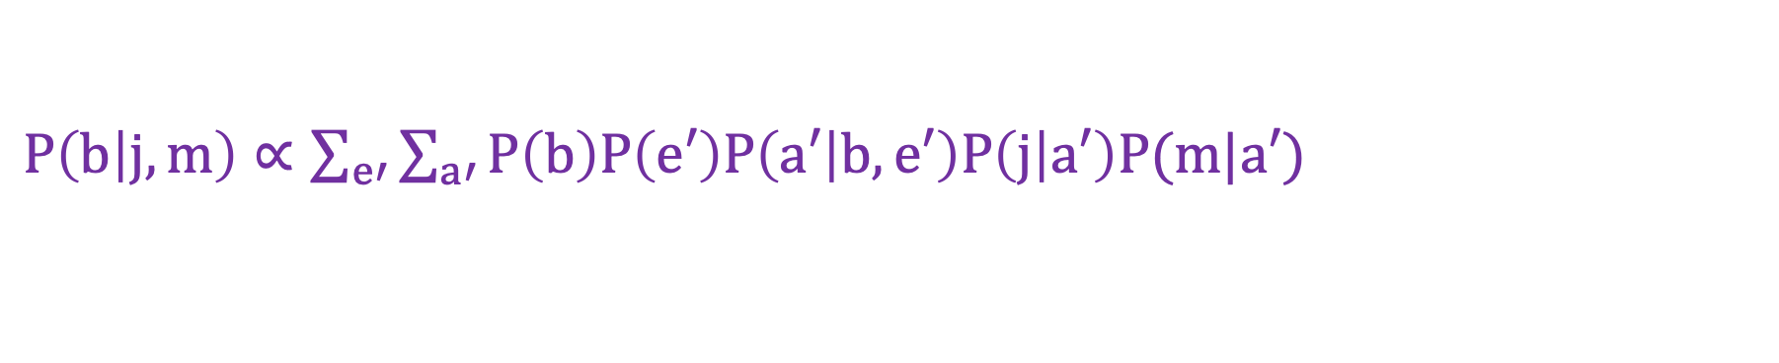
Complex Example
B | P(B)
b | 0.001
¬b | 0.999
E | P(B)
e | 0.002
¬e | 0.998
B
E
B | E | A | P(A|B,E)
b | e | a | 0.95
b | e | ¬a | 0.05
b | ¬e | a | 0.94
b | ¬e | ¬a | 0.06
¬b | e | a | 0.29
¬b | e | ¬a | 0.71
¬b | ¬e | a | 0.001
¬b | ¬e | ¬a | 0.999
A
M
J
A | M | P(M|A)
a | m | 0.7
a | ¬m | 0.3
¬a | m | 0.01
¬a | ¬m | 0.99
A | J | P(J|A)
a | j | 0.9
a | ¬j | 0.1
¬a | j | 0.05
¬a | ¬j | 0.95
$P\left(b | j,m\right)∝\sum_{e′}{\sum_{a′}{P\left(b\right)P\left(e′\right)P\left(a′ | b,e′\right)P\left(j | a′\right)P(m|a′)}}$

Slide 55
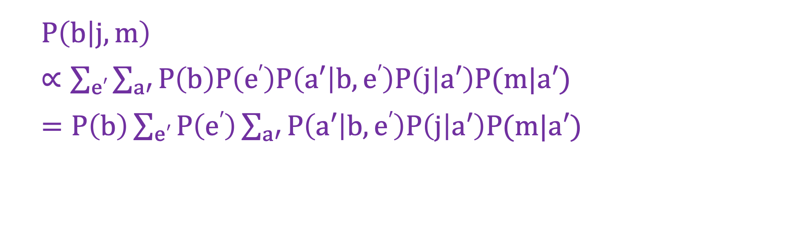
Speed-Up with Pulling Out Terms
B
E
A
M
J
$P\left(b | j,m\right)$
$∝\sum_{e′}{\sum_{a′}{P\left(b\right)P\left(e′\right)P\left(a′ | b,e′\right)P\left(j | a′\right)P(m|a′)}}$
$=P\left(b\right)\sum_{e′}{P\left(e′\right)\sum_{a′}{P\left(a′ | b,e′\right)P\left(j | a′\right)P(m|a′)}}$

Slide 56
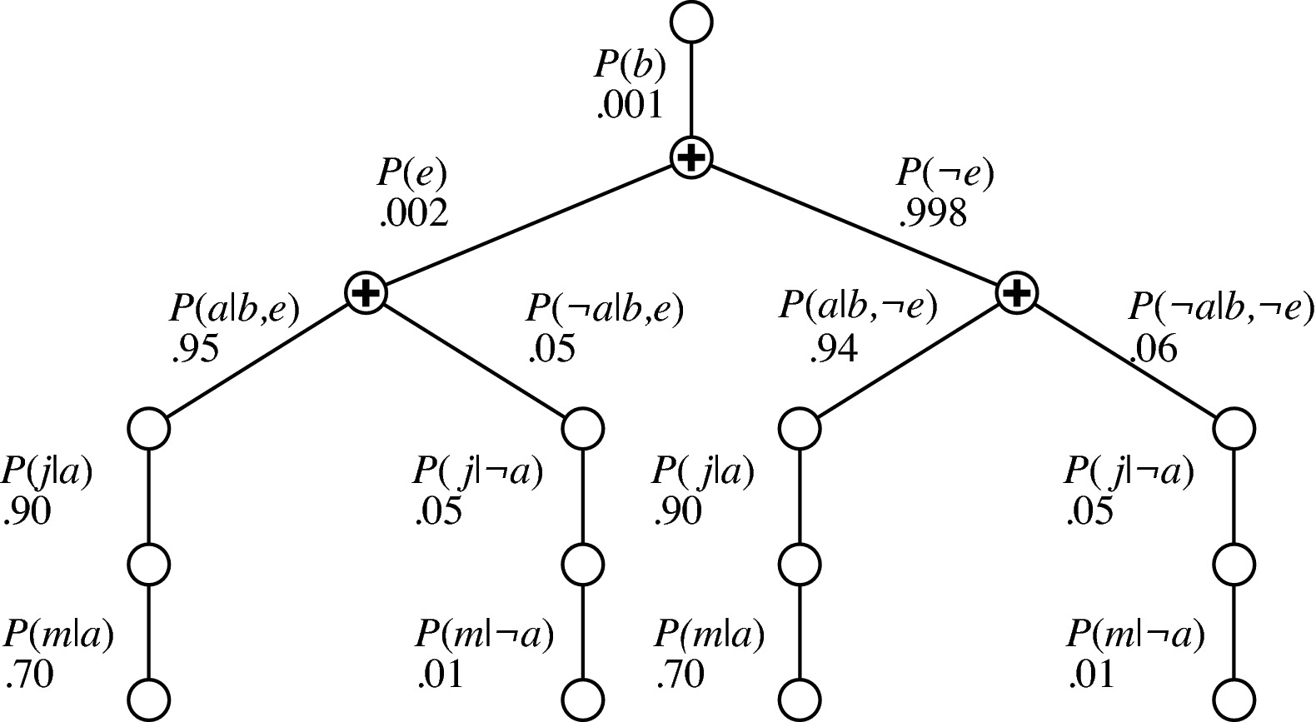
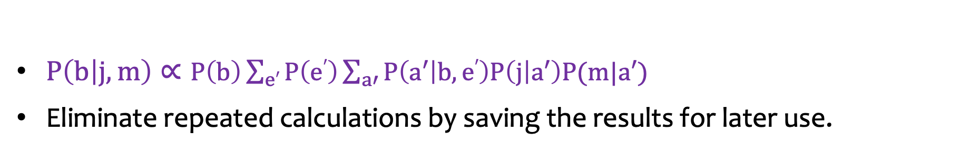
Speed-Up with Variable Elimination
B
E
A
M
J
$P\left(b | j,m\right)∝P\left(b\right)\sum_{e′}{P\left(e′\right)\sum_{a′}{P\left(a′ | b,e′\right)P\left(j | a′\right)P(m|a′)}}$
Eliminate repeated calculations by saving the results for later use.

Slide 57
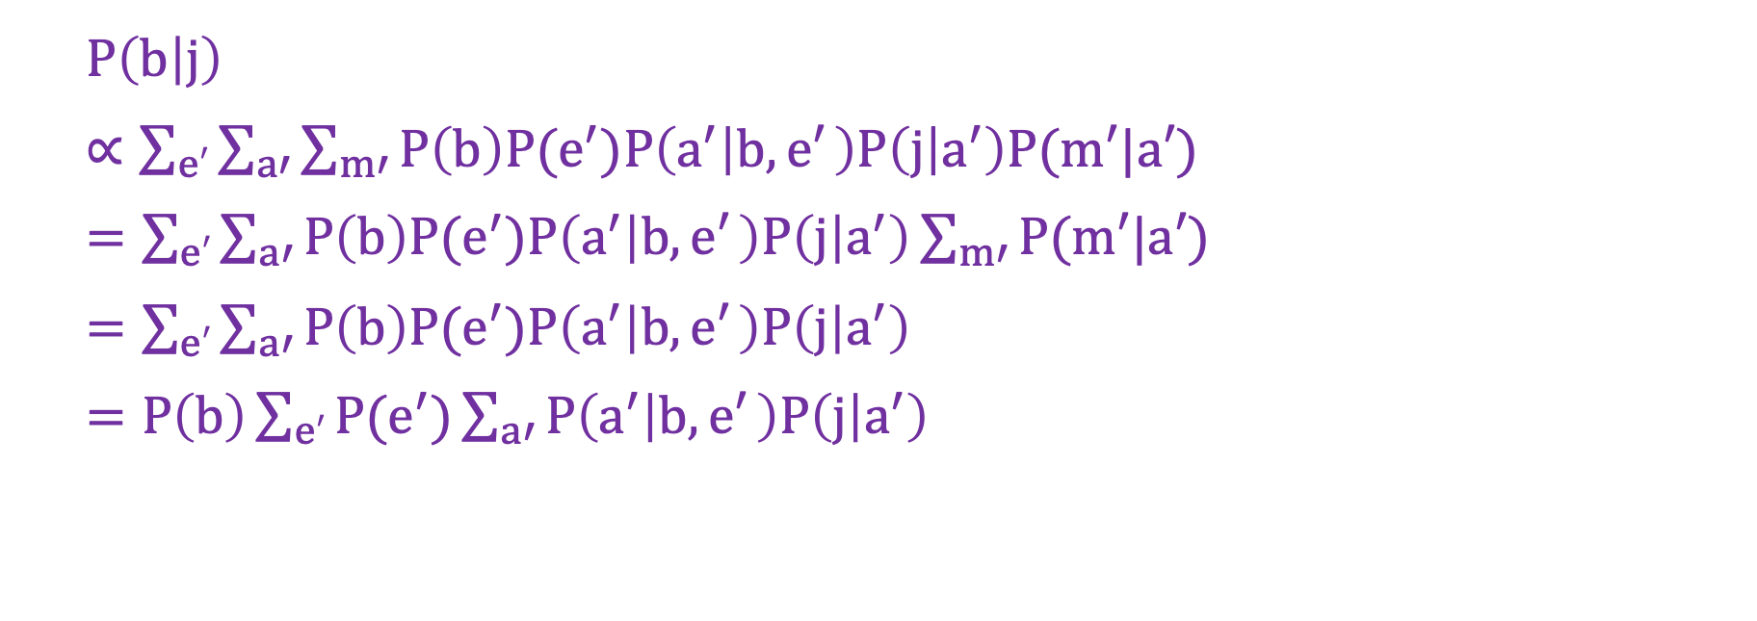
Speed-Up with Independency
B
E
A
M
J
$P\left(b | j\right)$
$∝\sum_{e′}{\sum_{a′}{\sum_{m′}{P\left(b\right)P(e^{′})P\left(a^{′} | b,e′ \right)P\left(j | a^{′}\right)P(m′|a′)}}}$
$=\sum_{e′}{\sum_{a′}{P\left(b\right)P(e^{′})P\left(a^{′} | b,e′ \right)P\left(j | a^{′}\right)\sum_{m′}{P(m′|a′)}}}$
$=\sum_{e′}{\sum_{a′}{P\left(b\right)P(e^{′})P\left(a^{′} | b,e′ \right)P\left(j | a^{′}\right)}}$
$=P\left(b\right)\sum_{e′}{P(e^{′})\sum_{a′}{P\left(a^{′} | b,e′ \right)P\left(j | a^{′}\right)}}$

Slide 58

Recall (Example: 2-Test Cancer)
C
P(c) = 0.01
P(t₁|c) = P(t₂|c) = 0.9
P(t₁|¬c) = P(t₂|¬c) = 0.2
T₁
T₂
P(t₁) = ?
= $\sum_{c′}{\sum_{t_{2}^{′}}{P(c^{′},t1{, t}_{2}^{′})}}$
= $\sum_{c′}{\sum_{t_{2}^{′}}{P({t1|c}^{′})P({t_{2}^{′}|c}^{′})P(c^{′})}}$
= $\sum_{c′}{P({t1|c}^{′})P(c^{′})}$
= P(t₁|c)P(c) + P(t₁|¬c)P(¬c)
= 0.9*0.01 + 0.2*0.99 = 0.207

Slide 59
Outline
Uncertainty
Bayes Rule
Bayesian Networks
D-Separation
Exact Inference
Approximate Inference: Sampling

Slide 60
Direct Sampling
B | P(B)
b | 0.001
¬b | 0.999
E | P(B)
e | 0.002
¬e | 0.998
B
E
B | E | A | P(A|B,E)
b | e | a | 0.95
b | e | ¬a | 0.05
b | ¬e | a | 0.94
b | ¬e | ¬a | 0.06
¬b | e | a | 0.29
¬b | e | ¬a | 0.71
¬b | ¬e | a | 0.001
¬b | ¬e | ¬a | 0.999
A
M
J
A | M | P(M|A)
a | m | 0.7
a | ¬m | 0.3
¬a | m | 0.01
¬a | ¬m | 0.99
A | J | P(J|A)
a | j | 0.9
a | ¬j | 0.1
¬a | j | 0.05
¬a | ¬j | 0.95
P(m)?
¬b, ¬e, ¬a, ¬m
¬b, ¬e, ¬a, ¬m
¬b, e, ¬a, ¬m
¬b, e, ¬a, ¬m
¬b, ¬e, ¬a, ¬m
¬b, ¬ e, ¬a, m
P(m) = Fraction of all sampled events.

Slide 61
Direct Sampling (cont’d)
B | P(B)
b | 0.001
¬b | 0.999
E | P(B)
e | 0.002
¬e | 0.998
B
E
B | E | A | P(A|B,E)
b | e | a | 0.95
b | e | ¬a | 0.05
b | ¬e | a | 0.94
b | ¬e | ¬a | 0.06
¬b | e | a | 0.29
¬b | e | ¬a | 0.71
¬b | ¬e | a | 0.001
¬b | ¬e | ¬a | 0.999
A
M
J
A | M | P(M|A)
a | m | 0.7
a | ¬m | 0.3
¬a | m | 0.01
¬a | ¬m | 0.99
A | J | P(J|A)
a | j | 0.9
a | ¬j | 0.1
¬a | j | 0.05
¬a | ¬j | 0.95
P(m|b)?
b, ¬e, a, ¬m
b, ¬e, a, ¬m
b, ¬e, a, m
b, ¬e, a, m
b, ¬e, a, ¬m
b, ¬e, a, ¬m

Slide 62
Hard-to-Sample Cases
B | P(B)
b | 0.001
¬b | 0.999
E | P(B)
e | 0.002
¬e | 0.998
B
E
B | E | A | P(A|B,E)
b | e | a | 0.95
b | e | ¬a | 0.05
b | ¬e | a | 0.94
b | ¬e | ¬a | 0.06
¬b | e | a | 0.29
¬b | e | ¬a | 0.71
¬b | ¬e | a | 0.001
¬b | ¬e | ¬a | 0.999
A
M
J
A | M | P(M|A)
a | m | 0.7
a | ¬m | 0.3
¬a | m | 0.01
¬a | ¬m | 0.99
A | J | P(J|A)
a | j | 0.9
a | ¬j | 0.1
¬a | j | 0.05
¬a | ¬j | 0.95
P(b|a)?

Slide 63
Rejection Sampling
B | P(B)
b | 0.001
¬b | 0.999
E | P(B)
e | 0.002
¬e | 0.998
B
E
B | E | A | P(A|B,E)
b | e | a | 0.95
b | e | ¬a | 0.05
b | ¬e | a | 0.94
b | ¬e | ¬a | 0.06
¬b | e | a | 0.29
¬b | e | ¬a | 0.71
¬b | ¬e | a | 0.001
¬b | ¬e | ¬a | 0.999
A
M
J
A | M | P(M|A)
a | m | 0.7
a | ¬m | 0.3
¬a | m | 0.01
¬a | ¬m | 0.99
A | J | P(J|A)
a | j | 0.9
a | ¬j | 0.1
¬a | j | 0.05
¬a | ¬j | 0.95
P(b|a)?
¬b, ¬e, ¬a
¬b, ¬e, ¬a
b, ¬e, a
¬b, e, ¬a
¬b, ¬e, ¬a
b, ¬e, ¬a
Problem: Reject too many samples! Not efficient!

Slide 64
Likelihood Weighting by Fixing Evidence
B | P(B)
b | 0.001
¬b | 0.999
E | P(B)
e | 0.002
¬e | 0.998
B
E
B | E | A | P(A|B,E)
b | e | a | 0.95
b | e | ¬a | 0.05
b | ¬e | a | 0.94
b | ¬e | ¬a | 0.06
¬b | e | a | 0.29
¬b | e | ¬a | 0.71
¬b | ¬e | a | 0.001
¬b | ¬e | ¬a | 0.999
A
M
J
A | M | P(M|A)
a | m | 0.7
a | ¬m | 0.3
¬a | m | 0.01
¬a | ¬m | 0.99
A | J | P(J|A)
a | j | 0.9
a | ¬j | 0.1
¬a | j | 0.05
¬a | ¬j | 0.95
P(b|a)?
¬b
¬b
b
¬e
¬e
¬e
a
w=0.001
a
w=0.001
a
w=0.94

Slide 65
Likelihood Weighting by Fixing Evidence
B | P(B)
b | 0.001
¬b | 0.999
E | P(B)
e | 0.002
¬e | 0.998
B
E
B | E | A | P(A|B,E)
b | e | a | 0.95
b | e | ¬a | 0.05
b | ¬e | a | 0.94
b | ¬e | ¬a | 0.06
¬b | e | a | 0.29
¬b | e | ¬a | 0.71
¬b | ¬e | a | 0.001
¬b | ¬e | ¬a | 0.999
A
M
J
A | M | P(M|A)
a | m | 0.7
a | ¬m | 0.3
¬a | m | 0.01
¬a | ¬m | 0.99
A | J | P(J|A)
a | j | 0.9
a | ¬j | 0.1
¬a | j | 0.05
¬a | ¬j | 0.95
P(a|b, j)?
b
b
¬e
¬e
a
¬a
j
w=0.9
j
w=0.05

Slide 66
Backup

Slide 67
Markov chain Monte Carlo (MCMC) Sampling Algorithms
Rejection sampling and likelihood weighting:
Generating each sample from scratch independently.
MCMC algorithms generate each sample by making a random change to the preceding sample.

Slide 68
Markov Chain for P(A,B|e,m,j)
b
e
¬b
e
a
a
m
j
m
j
b
e
¬b
e
¬a
¬a
m
j
m
j
Wander about for a while, average what you see.

Slide 69
Gibbs Sampling
B
e
It is one of MCMC algorithms.
It generates a next state by randomly sampling a value for one of the nonevidence variables X_{i}.
A
m
j
P(A,B|e,m,j) = ?
Randomly initialize: b, e, j, ¬a, m
Randomly pick B and sample B based on P(B|e,j,¬a,m): ¬b, e, j, ¬a, m
Randomly pick A and sample A based on P(A|¬b,e,j,m): ¬b, e, j, ¬a, m
…

